Slide 1
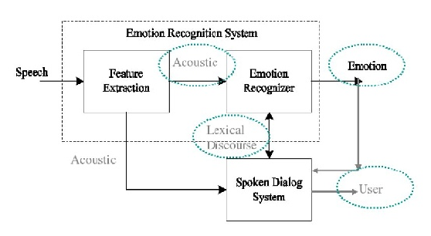
FACIAL EXPRESSION
RECOGNITION SYSTEM
Recognising emotions from ensemble of features
INPUT DATA STAGE PRE-PROCESSING FEATURE EXTRACTION FEATURE CLASSIFICATION EMOTION DETECTED
ABOUT THE PROBLEM
To put some limelight on socializing robots with human, understanding the facial gestures and visual cues of an individual is a need. It allows a robot to understand the expressions of humans enhancing its effectiveness in performing various tasks.
It serves as a measurement systems for behavioural science.
Socially intelligent software tools can be accomplished which are economically viable and can boost profit marketing.
OBJECTIVE
To develop a prototype to determine facial expressions corresponding to the basic emotions.
To identify the suitable image processing techniques for facial expression recognition

Slide 2
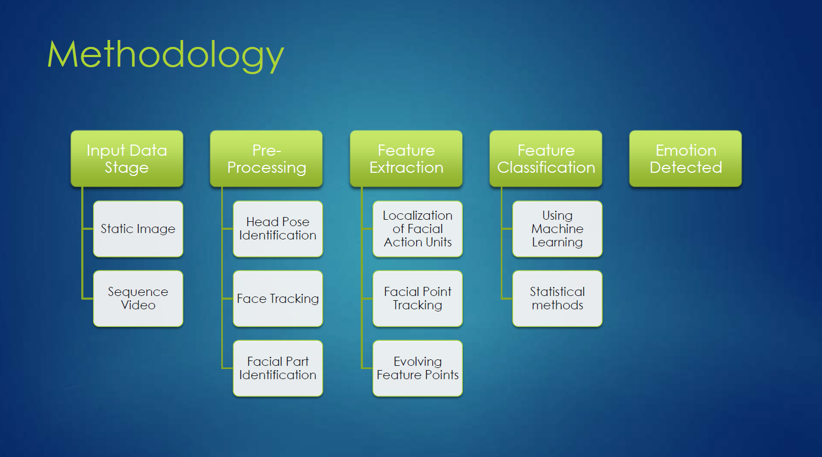
Using Fisher Face Recognizer Algorithm

Slide 3
PROGRAMMING ENVIRONMENT
Anaconda Spyder
TECH STACK
OpenCV
Machine Learning (PYTHON)
Fisher Face Recognizer Classifier
Haar Cascade Classifier

Slide 4
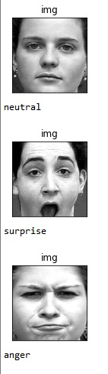
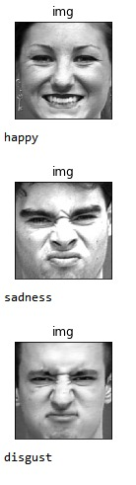
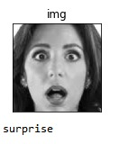
DEMONSTRATION

Slide 5
BUSINESS RELIABILITY
FaceReader could be an effective tool to evaluate consumer emotion in the field of design research.
The importance and practicality of using Real-time facial expression recognition to evaluate participants’ emotions in response to different pop-up advertisements is emphasized.
This approach provides a preferable basis in relevant fields of ad design practice and product marketing.

Slide 6
FUTURE SCOPE
The range of age of the samples is 18-26 years old based on physical expression .
The lighting condition is always consistent with 220-240V 50Hz fluorescent lamp.
Images taken had length range from 350*350 px between the camera and the samples.
Only one sample is being captured during image acquisition phase for each testing conducted.
This system is not a fully automated system.

Slide 7
MEMBERS
Pratyush Sharma
Rahul Singh Rawat
Mohit Gupta
Disha Varshney

